Slide 1
Formal Methods in software engineering
Lecture 01
Ms. Rabia Iftikhar
rabia.iftikhar@faculty.muet.edu.pk

Slide 2
Outline
Errors and Patch
High Integrity Software
The Importance of the Specification
Formal Methods

Slide 3
High Integrity Software Development
Today, software is pervasive. It is used not only to provide applications on our desktop PC, or distributed business applications across a network of machines, but also to control many systems all around us.
Often the software is integrated into a mechanical or electronic system known as embedded software.

Slide 4
High Integrity Software Development
Errors and Patch
Ideally all software products, be they traditional off-the-shelf desktop products such as word processors, or specialist embedded software dedicated to monitoring temperatures in a chemical reactor, should be released without errors.
In reality this is not feasible and residual errors in applications are to be expected.
Examples
when it comes to off-the-shelf software products, it is common for software companies developing such products to release ‘patches’ for them. Essentially, these patches are fixes for mistakes in the application’s original source code.
Manufacturers of operating systems, for example, often find the need to release patches for their products soon after release, as errors are uncovered.

Slide 5
High Integrity Software Development
Errors and Patch
Consumers tolerate a certain level of residual errors in such applications, as the consequence of software failure is not disastrous.
Sometimes a system reboot may solve the problem; other times the product might not be usable until a patch is available.
While this may be annoying it does not pose any danger. For these kinds of products, delivering the product quickly to market, and at an affordable price, is more important than reducing defects to an absolute minimum.
However, if similar patches were suddenly released for software controlling the brakes on your car or the signaling system on a railway network! For these kinds of systems (compared to off-the-shelf desktop applications) the costs of software failure are dangerously high and therefore a much higher degree of confidence in the correctness of the software is required.

Slide 6
High Integrity Software Development
High Integrity Software
We refer to software that has a higher than normal expectation of correctness as high integrity software.
This expectation of correctness is closely linked to the risks inherent in software failure.
As risks increase so too does the need to ensure that there are as few software errors as possible.
However, the resources (cost, time and so on) required to help ensure correctness also rise.
Therefore, the development of high integrity software demands greater resources than the development of a ‘regular’ software product.

Slide 7
High Integrity Software Development
Critical Software
The term critical software applies to software that poses dangers should it fail.
Critical software can further be categorized depending upon the types of danger imposed by failure.
Failure of business critical software could adversely affect the economic success of an enterprise
Example includes the software used to control a bank’s ATM transactions and software aimed at providing security for sensitive information.
Failure in mission critical software, on the other hand, could impair the goal of the given mission.
Examples here include such applications as satellite and rocket launch systems.
Finally, failure of safety critical software could result in harm to people, property or the environment.
Examples include medical control software and air traffic control software.

Slide 8
High Integrity Software Development
Integrity Levels
There can be degrees of danger posed by software failure, so that some software is of higher integrity than other software
a higher degree of confidence is required in its correctness than is the case for other software.
For example, consider the software used to monitor air traffic flow around an airport and software used to monitor the temperature in a fridge freezer. Although both are examples of critical software, failure in the former could have far more catastrophic consequences than failure in the latter.
Amongst other things, software failure in a fridge freezer is likely to be protected against by some form of hardware lock, whereas hardware locks cannot protect against errors in air traffic software.
We refer to these degrees of integrity as integrity levels.

Slide 9
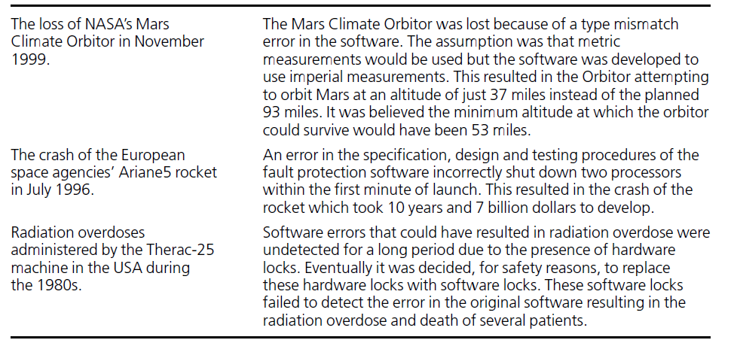
High Integrity Software Development
Some high profile examples of high integrity software failures

Slide 10
High Integrity Software Development
The Importance of the Specification
When we say that a piece of software contains an ‘error’ we mean it does not behave as expected.
There could be two reasons for this: either the software does not conform to its specification or there are errors or omissions in the original specification.
For the software development methods, it is the process of testing that aims to locate these software errors.
Testing involves running a program with a set of inputs and comparing the actual outputs from the program against the expected outputs (as defined in the specification).

Slide 11
High Integrity Software Development
Testing: Limitations
There are several limitations to using testing as the sole approach to software error detection:
Testing cannot take place until some implementation is available, so correcting errors uncovered by testing could involve retracing many steps and undoing work previously done. The earlier the error occurred the more work this involves. If testing is the only approach to error detection then errors in the specification involve the greatest amount of work to rectify.
Testing can only help to uncover errors – it cannot guarantee the absence of them. Since, for any application, it is impossible to test every set of input values, residual errors will always have to be accepted.
Testing is always carried out with respect to requirements as laid down in the specification. If the specification document is in any way ambiguous it is open to interpretation, and hence misinterpretation, making testing a rather inexact science.

Slide 12
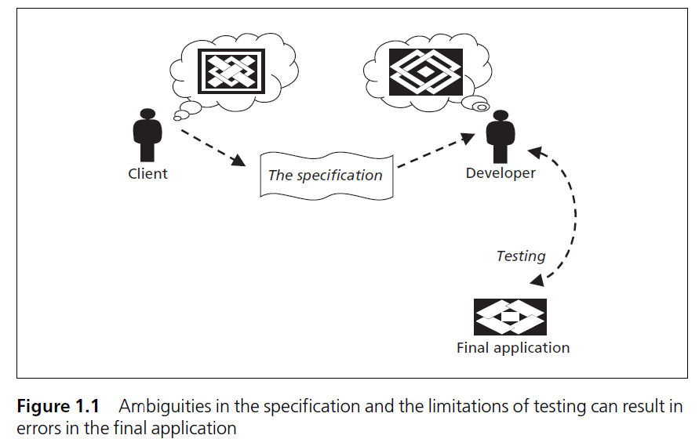
High Integrity Software Development

Slide 13
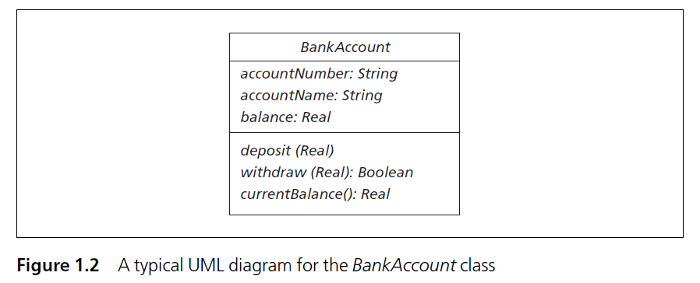
High Integrity Software Development
The Importance of the Specification
Clearly the specification plays a vital role in the reliability of the software produced.
For the vast majority of software applications in use today, the specification is captured in a mix of natural language and diagrams.
For example, the Unified Modelling Language (UML) notation is used to specify and design systems according to the principles of object-oriented development.

Slide 14
High Integrity Software Development
The Importance of the Specification
Often, a diagram such as this is supplemented by a natural language description for each method. For example, the withdraw method of the BankAccount class might have its UML specification supplemented with the following natural language description:
withdraw: receives a requested amount to withdraw from the bank account and, if there are sufficient funds in the account, meets the request. Returns a boolean value indicating success or failure of the attempt to withdraw money from the account.
Diagrams and natural language descriptions, such as this, have the advantage that they are easy to follow by non-computing experts and so provide a good medium for discussions with clients. Unfortunately, natural language and diagrams do not have a fixed meaning from one person to the next and so are open to many different interpretations. We say these notations do not have a fixed semantics.

Slide 15
High Integrity Software Development
The Importance of the Specification
Often, a diagram such as this is supplemented by a natural language description for each method. For example, the withdraw method of the BankAccount class might have its UML specification supplemented with the following natural language description:
withdraw: receives a requested amount to withdraw from the bank account and, if there are sufficient funds in the account, meets the request. Returns a boolean value indicating success or failure of the attempt to withdraw money from the account.
The withdraw method is:
Ambiguous: use of term “sufficient”
Incomplete: Behavior is not defined for insufficient amount
Inconsistent: overdraft facility not defined

Slide 16
High Integrity Software Development
The Importance of the Specification
With misinterpretations of a few lines like this, think how many different ways a specification running to many dozens of pages could be interpreted.
Clearly, to use these notations alone to describe critical software is unwise.
To overcome these difficulties it is desirable to use a specification notation with a fixed, unambiguous semantics.

Slide 17
High Integrity Software Development
The Importance of the Specification
Notations that have a fixed semantics are known as formal notations, or formal languages.
A fixed semantics is achieved by defining a language in a completely unambiguous way using a mathematical framework.
Ideally a specification should describe what the system is to do without saying how to do it. That is, a specification should be as abstract (not cluttered by implementation details) as possible.
The language of mathematics is perfectly suited for this task as it allows a far more abstract description of the system to be captured using simple mathematical concepts such as sets, relations and functions.
In all other branches of engineering (such as civil, mechanical and electrical), the use of mathematics to help build reliable products is the normal approach.
The idea that an aircraft or a bridge would be constructed without the aid of mathematical models, or the idea that the only way to identify defects would be to observe the behavior of test scenarios after the construction of the final system, would be unthinkable. Yet this is how the large majority of software applications are developed!

Slide 18
High Integrity Software Development
Testing & Formal Methods
In theory, if every transformation can be shown to describe a system whose behavior is consistent with the previous step then, by the time the last step is reached, the final program will have been shown to be consistent with the original specification. This is a much more robust approach to checking for program correctness than testing alone, as proofs demonstrate correctness for all possible test cases, whereas testing demonstrates correctness only for the test cases investigated.
In reality the skill (and tools) required to carry out such a proof means that the proofs could themselves contain errors. Also, there is no guarantee that the initial formal specification captures the original user requirements accurately, and there is always the risk of introducing erroneous behavior when replacing the abstract data structures in the specification (such as sets and mappings) with their more concrete code-level counterparts (such as arrays and linked lists). For this reason, testing still plays an important role in a formal approach to software development.

Slide 19
High Integrity Software Development
Mathematical based techniques for specification, development and verification of software and hardware Systems
Formal methods = Formal Specification
+
Refinement
+
Formal Verification
Set theory, logics, algebra, etc.

Slide 20
High Integrity Software Development
Two well established approaches to verification
Model Checking
Theorem Proving
Model checking
Build a finite model of system and perform an exhaustive search
Disadvantage – STATE EXPLOSION PROBLEM
Theorem Proving
Mechanization of a logical proof
Both the system and its desired properties are expressed in some mathematical logic

Slide 21
High Integrity Software Development
Formal methods can also be understood as the following three components:
Formal notation (or language) for writing specifications.
Logical calculus for formal verification (or proof)
Method for developing software systems.

Slide 22
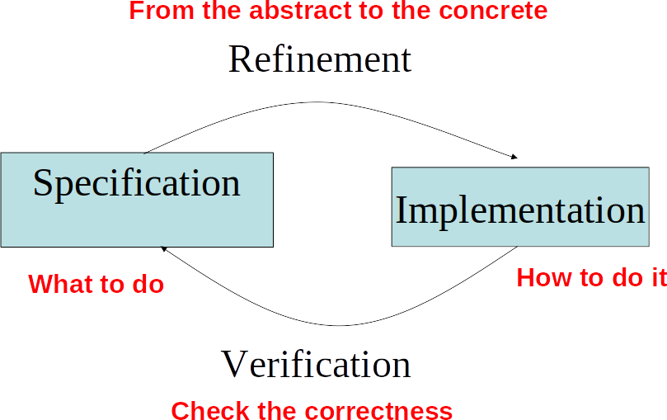

Slide 23
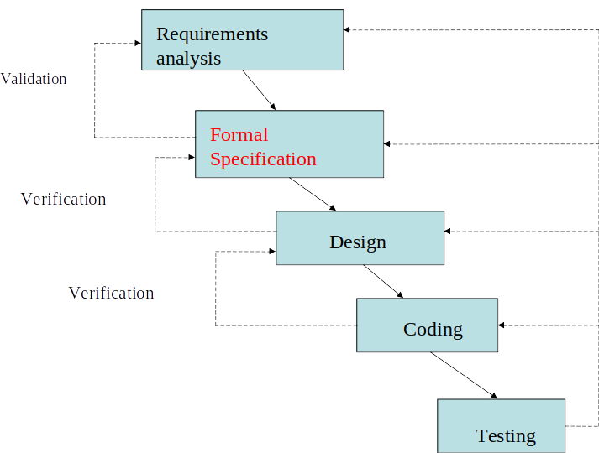

Slide 24
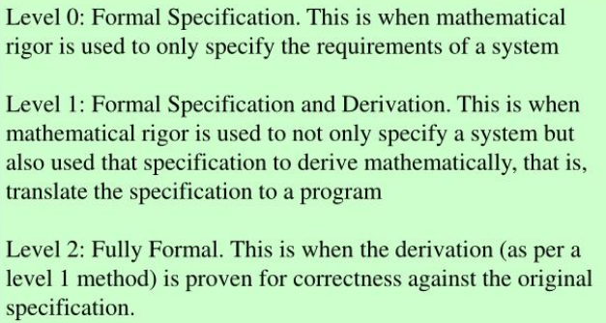
Formal Methods Scopes
High Integrity Software Development
Formal methods come under many scopes and uses

Slide 25
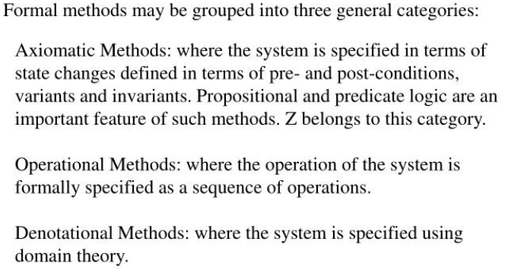
Formal Methods Scopes
High Integrity Software Development

Slide 26
High Integrity Software Development
The use of formal methods poses some disadvantages:
Formal specifications of large-scale and complex software systems can be difficult to write, to read, and to understand for many engineers in industry.
Communications between clients and developers via formal specifications can be difficult.
Modifications of formal specifications for consistency during a project can be time-consuming and costly.
Formal verification is difficult to perform and is not cost-effective for the assurance of program correctness.
The tool support does not necessarily reduce the difficulty of using formal methods.

Slide 27
Questions
Identify five examples of safety critical software and try and rank them in terms of their levels of integrity.
Give an example of software that is both mission and safety critical.
Why testing cannot guarantee that a program is correct.
Why is natural language a poor choice for expressing specifications?
Identify any weaknesses in the following requirements definition:
‘Software is required to monitor a collection of documents kept in a library. There may be multiple copies of each document. Some of the documents are deemed to be of high importance. Documents can be borrowed from the library by certain members of staff. There must always be at least one copy of any document deemed to be of high importance left in the library. All other documents may be removed. The software needs to record each document’s identity code (consisting of letters and numbers), and whether or not it is of high importance, as well as the number of copies. Documents can be removed from the library only by providing the correct document code.’

